Slide 1
EXPLORING RESTAURANTS IN THE NEIGHBORHOODS OF HYDERABAD, INDIA
By : A.NIKETH

Slide 2
INTRODUCTION
The biryani destination of India – Hyderabad, can spoil you with delicious choices when it comes to food. There's actually so much more to Hyderabadi food than the famed biryani. The food culture of Hyderabad offers a beautiful blend of Deccani and Telugu cuisines, with slight influences of Marathwada, Arabic, and Mughlai culinary styles.
In this project, best restaurants in Hyderabad for several categories, such as fine dining, north Indian, south Indian, global and regional food, were selected and sorted according to their pricing and its reviews.

Slide 3
BUSINESS PROBLEM
Suppose a person visits Hyderabad for the first time and wants to explore the city, in this situation food can be an important factor for decided how you rate your trips and also recommend it to the people. In such scenarios, we need to find the right place having good reviews and are at a reasonable price to serve them in the best possible way.
This information helps them to decide which restaurant to choose amongst many restaurants in the city. Thus combining the restaurants in a neighborhood with their average prices and rating information would surely help the visitors take better decisions about the restaurants to visit.

Slide 4
DATA
Neighborhoods of Hyderabad data is obtained from Wikipedia (https://en.wikipedia.org/wiki/Category:Neighbourhoods_in_Hyderabad,_India)
To get the locations for these neighborhoods, Geocoder Python package was used.
For obtaining the venues in these neighborhoods, Foursquare API is used in which venues were fetched in a neighborhood for a radius of 1 kilometer and their names, category and location were collected.
Using the venues, latitude and longitude obtained from Foursquare API, venues from Zomato search API were obtained.

Slide 5
METHODOLOGY
Web scraping Wikipedia page for the neighborhoods of Hyderabad.
Get latitude and longitudes for the neighborhoods using Geocoder.
Use Foursquare API for the data of the venues for the neighborhood within a radius of 1 kilometer.
Filtering the venue category by restaurants.
Use Zomato API for obtaining restaurants for the venues in foursquare API data.
Visualizing the data obtained from both the API’s.
Perform clustering on the data using K-Means clustering.
Visualizing the clusters on map using Folium.

Slide 6
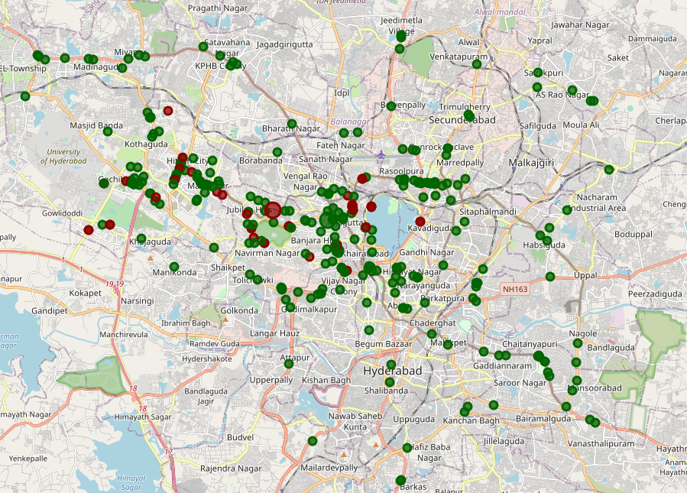
RESULTS AND DISCUSSION
Categorized the restaurants in the neighborhoods into 2 clusters.
The first cluster(0) of color green has majority of the restaurants and are spread across the whole city, while the second cluster(1) of color red has very few restaurants and are sparsely spread.

Slide 7
Contd.
The restaurants which are lower priced have mean price range of 1.82 with average price per person ranging from 50 to 600 INR and mean rating spread around 3.78.
The restaurants which are higher priced have mean price range of 3.27 with average price per person ranging from 650 to 2000 INR and mean rating spread around 4.24.

Slide 8
CONCLUSION
This exploration of restaurants in the neighborhoods of Hyderabad considers factors such as price, ratings and makes use of Foursquare and Zomato API's to determine the nearby venues. The data obtained in this project will not only help the people who visits Hyderabad for first time but also to the people in Hyderabad who rarely use restaurants would prefer to have the most rated restaurants nearby them. Also a company can use this information to create a website or application to the individuals in the city or even expand same functionality to other places.

